Slide 1
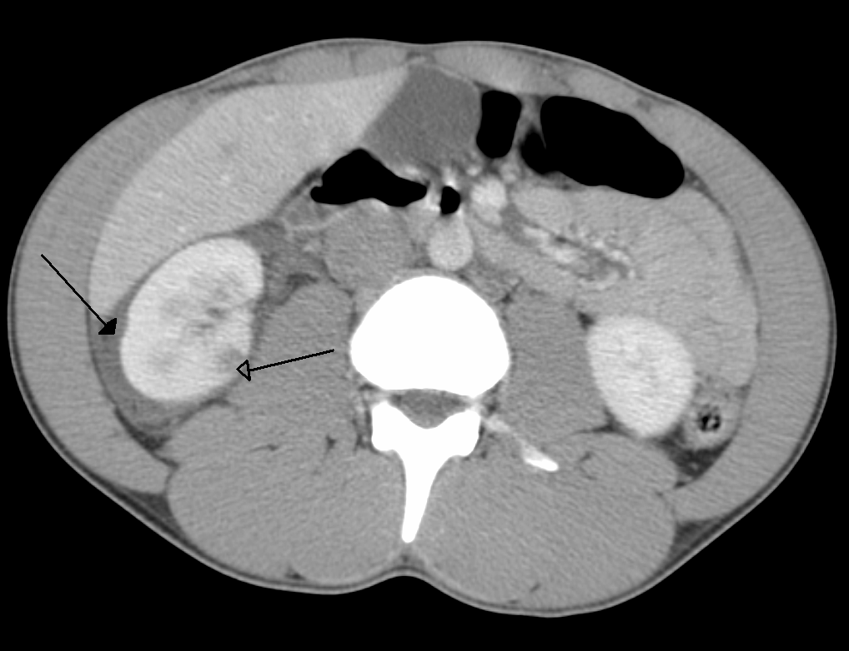
ABDOMINAL TRAUMA CLASSIFICATION AND SEVERITY PREDICTION
By::
Catherine Gakii
Lee Kimaita
Wilfred Njagi
Brenda Kinya
Joyce Muthike
Daniel Ndirangu
Joy Kamau

Slide 2

Project Overview
Project Objective: Address the critical issue of prompt and accurate diagnosis of abdominal trauma.
Significance: Abdominal trauma is a common cause of death and a major global public health concern.
Causes: Often results from motor vehicle accidents.
Consequences: Can lead to severe injuries to internal organs and internal bleeding.

Slide 3
Problem Statement
Over 5 million people worldwide succumb to traumatic injuries annually, creating a severe public health crisis.
Blunt abdominal trauma from car accidents often leads to internal bleeding and severe damage.
Kenya, with a population of over 50 million, faces significant healthcare system issues.
Only 200 trained radiologists and approximately 50 CT scanners exist across the entire state, resulting in:
Frequent False Positives
Extended Wait Times (often weeks)
A considerable portion of the Kenyan population lacks access to essential healthcare services.
The urgency for swift and accurate diagnosis persists, despite government efforts to increase CT scanners and train more radiologists.

Slide 4

Objectives
To develop AI algorithms that can automatically and accurately detect traumatic injuries to internal abdominal organs using CT scans.
To classify the discovered injuries according to their severity, thereby providing medical experts a vital tool to start proper treatment.
To rigorously evaluate the developed algorithms using performance metrics that are relevant for both machine learning models and clinical applicability.

Slide 5

Research Questions
How effective are AI algorithms in automatically detecting traumatic injuries to internal abdominal organs like the liver, kidneys, spleen, and bowel using CT scans?
What features and patterns in CT scans are most indicative of different severities of abdominal injuries, and how can they be utilized for automated injury grading?
What are the appropriate metrics for evaluating the performance of the developed AI algorithms in terms of both machine learning benchmarks and clinical utility?

Slide 6

Data Understanding
1. labels (image_level_labels.csv) Dataset:
Rows: 12,029
Columns: 4
Columns include patient_id, series_id, instance_number, and injury_name.
Data Types: Integer types for identifiers and string for injury names.
Unique Values: 246 unique patients, 330 unique series, 925 unique instances, 2 unique injury types (Active_Extravasation and bowel).
2. train (train.csv) Dataset:
Rows: 3,147
Columns: 15
Columns include patient_id, 'any_injury', and 13 binary variables for organ health and injury presence.
Data Types: All columns are integers.
Unique Values: 3,147 unique patients, binary injury-related columns.
3. train_meta (train_series_meta.csv) Dataset:
Rows: 4,711
Columns: 4
Columns include patient_id, series_id, aortic_hu, and incomplete_organ.
Data Types: Integer and float types.
Unique Values: 3,147 unique patients, 4,711 unique series, binary incomplete organ feature.
Notes:
**1. labels (image_level_labels.csv) Dataset:**
- Number of Rows: 12,029
- Number of Columns: 4
- Columns:
- patient_id: Unique identifier of the patient.
- series_id: An identifier for the series of images associated with each patient..
- instance_number: Specific image instance number within the series.
- injury_name: Type of injury detected in the image.
- Data Types: The data types are appropriate with integer types for identifiers and object (string) type for the injury name.
- Unique Values: There are 246 unique patients, 330 unique series, 925 unique instance numbers and **2 unique injury types; Active_Extravasation and bowel.**
"***Note:*** *Active extravasation in relation to abdominal trauma is the leakage of blood from a blood vessel in the abdomen into the surrounding tissue leading to organ failure or death."*
**2. train(train.csv) Dataset:**
- Number of Rows: 3,147
- Number of Columns: 15
- Columns:
- patient_id: Unique identifier of the patient.
- 'any_injury': It serves as a binary indicator representing the presence or absence of any abdominal injury for each patient. A binary variable like 'any_injury' is often used to simplify complex conditions into a format that machine learning algorithms can process.
- The other 13 columns represent the health status and injury severity of various organs in the adnomen for each patient, namely; the bowel, extravasation, the kidney, the liver and the spleen. They are recorded as binary variables where 0 indicates the absence of a condition, and 1 indicates the presence of a condition.
- Data Types: All columns are of integer type.
- Unique Values: There are 3,147 unique patients. The injury-related columns have binary values (0 or 1), indicating the absence or presence of a specific injury type.
**3. train_meta (train_series_meta.csv) Dataset:**
- Number of Rows: 4,711
- Number of Columns: 4
- Columns:
- patient_id: Unique identifier of the patient.
- series_id: An identifier for the series of images associated with each patient..
- aortic_hu: A quantitative measure of the aorta's radiodensity in Hounsfield units(HU) on a CT scan. It is measured on a scale of -1000 to 1000 and normally ranges between 150 and 400 HU depending on the patient's age, sex, and other factors.
- incomplete_organ: A feature in medical imaging representing the presence of an organ that is not fully formed. It's a binary feature where 0 signifies the absence of an incomplete organ, and 1 signifies the presence of an incomplete organ.
- Data Types: The data types are appropriate with integer and float types.
- Unique Values: There are 3,147 unique patients, 4,711 unique series and the incomplete_organ column has binary values (0 or 1) indicating the absence or presence of an incomplete organ in the imaging.

Slide 7
Data Understanding
Statistical Summary - Train Dataset
Patient IDs Distribution:
Wide range of patient IDs, from 19 to 65,508.
Organ Health Status:
Binary indicators of organ health.
Most patients have healthy organs (mean values close to 1).
Organ Injury Severity:
Binary indicators of injury severity.
Low mean values, indicating rare severe injuries.
Overall Injury Presence:
'any_injury' column indicates the presence of any injury.
Approximately 27% of patients have at least one injury.
Notes:
Relatively imbalanced dataset with most patients having healthy organs.
Around 27% of patients have at least one injury.
Further analysis needed to understand injury characteristics and their impact on patient outcomes.

Slide 8
Data Understanding
Statistical Summary - Train_Meta Dataset
Aortic Hounsfield Units (HU):
Mean HU value: ~223.62, indicating moderate density.
Significant HU value spread (std. dev. ~103.77).
Outliers with min -1024 and max 1411.
Incomplete Organ:
Mean value: ~0.066, suggesting rare presence.
Some variability (std. dev. ~0.249).
Notes:
Address potential outliers in aortic_hu column.
Investigate cases with incomplete organs.
Further analysis and visualization needed to explore relationships and clinical significance.

Slide 9
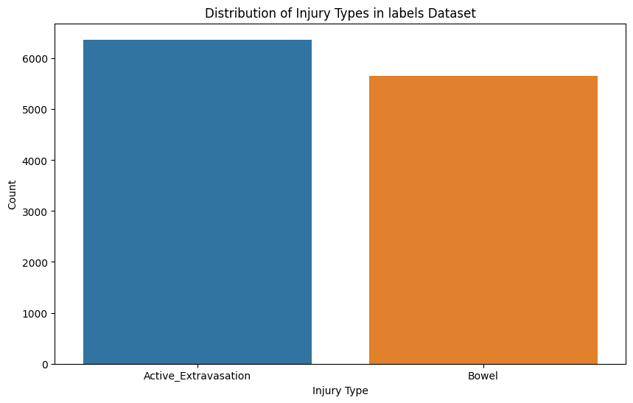
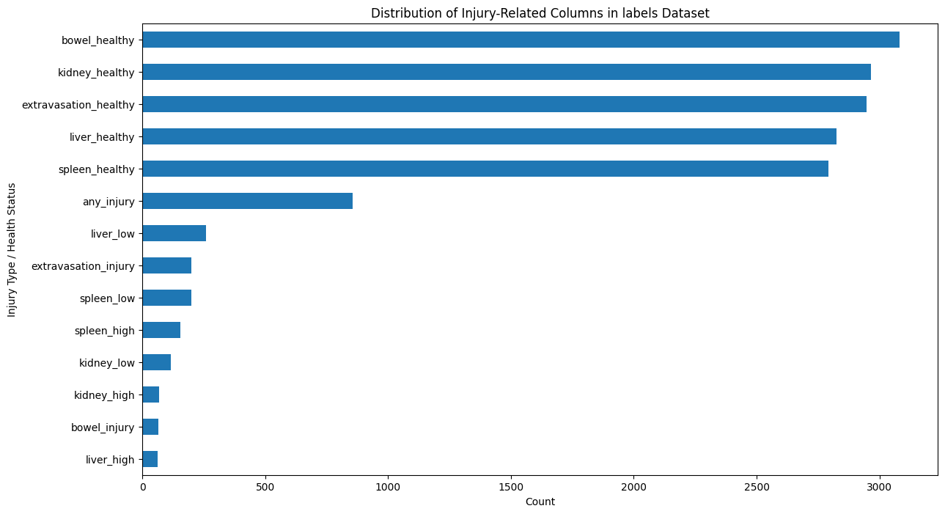
Univariate EDA
Notes:
This is a visualization of the data to help in more understanding:
The data suggests that extravasation (active bleeding) is more frequently identified in the provided images as compared to bowel injuries.
- This is an indication of class imbalance in the dataset which could potentially impact our model performance. There will be need to address this imbalance to avoid model bias towards the majority class ('Active_Extravasation') and difficulty in accurately predicting the minority class ('Bowel’)
We plotted a horizontal bar chart to illustrates the distribution of injury-related columns in the 'train' dataset.
- Each bar represents the count of occurrences for a specific injury type or health status, providing a clear visual comparison of their frequencies
- Of the abdominal injuries, the liver low severity is more prominent with liver high severity being the least recurring.

Slide 10
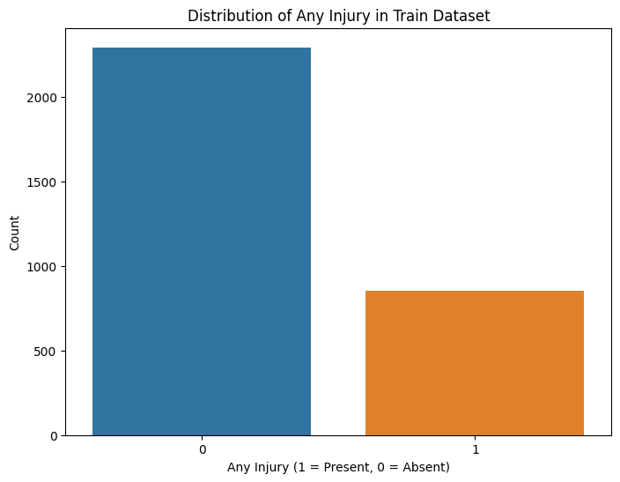
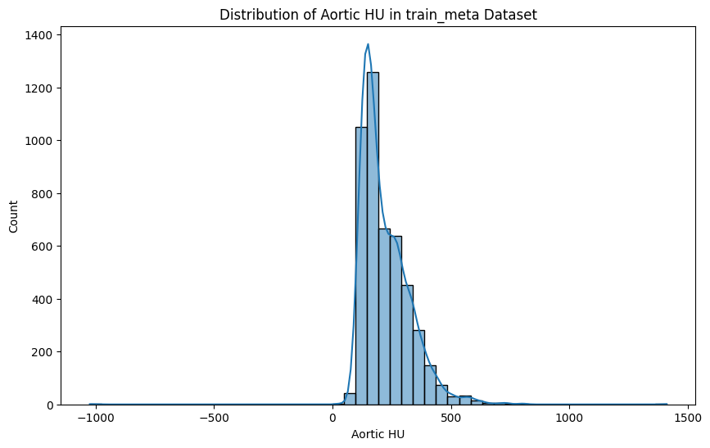
Univariate EDA
Notes:
- We plotted a countplot above to help illustrae the distribution of 'Any Injury' instances in the training dataset and get insights into the **class distribution of our potential target variable.**
- This analysis revealed a notable prevalence of cases without injuries ('Any Injury'=0) compared to instances indicating the presence of injuries ('Any Injury'=1).
- **These findings provide a foundational understanding for our predictive modeling efforts, highlighting the significant class imbalance that will need to be addressed to ensure accurate predictions.**
- We plotted a histogram for the Aortic HU feature in the train_meta dataset to provide insights into how it's values are spread across different ranges and to also provide some visual indications of it's skewness and outliers .
- The distribution of the aortic Hounsfield Units (HU) gives us an idea of the variation in these values across different images. They seem to be majorly **distributed between 0 to 800** with **visible outliers.**
- In the context of kurtosis, the pointed peak in the histogram suggests a leptokurtic distribution. This indicates that there are many observations clustered closely around the mean indicating a higher degree of peakedness and less variability in the dataset,
- The distribution also has a longer right tail indicating positive skeweness. This skewness indicates that while the central tendency is higher, there are relatively few, but potentially significantly higher, values present on the right side of the distribution.

Slide 11
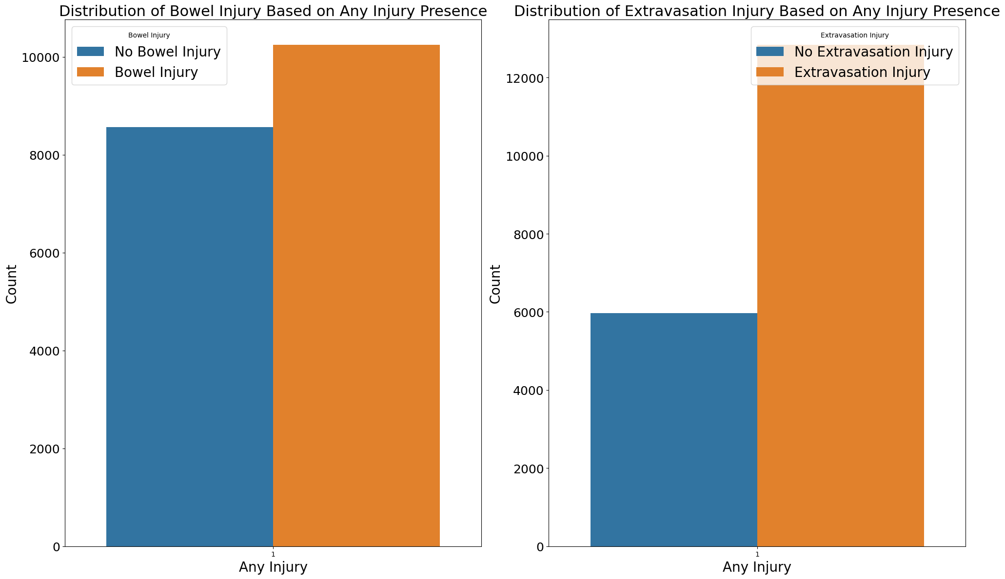
Bivariate EDA
We used a grouped bar chart to compare 'Bowel Injury' and 'Extravasation Injury' based on the presence or absence of any injury.
n cases with any injury ('any_injury=1'), 'Bowel Injury' is slightly more prevalent compared to cases without injury.
in cases with any injury, 'Extravasation Injury' is significantly more prevalent than cases without injury
Notes:
- We plotted a **grouped bar chart** above to provide a clear comparison of binary patient features ('Bowel Injury' and 'Extravasation Injury') based on the presence or absence of any injury.
- Upon analysis, it is evident that in the presence of injury ('any_injury=1), bowel injury cases exhibit a slightly higher prevalence compared to cases without. Similarly, in the presence of any injury, 'Extravasation Injury' cases are significantly more prevalent than those without.
- **This analysis therefore reveals the prevalence of 'Bowel Injury' and 'Extravasation Injury' within the dataset.** These insights are an indication of which injuries are more commonly associated with patients who have **any type of abdominal injury.**
- **The'Bowel Injury' and 'Extravasation Injury' features will therefore serve as essential predictors.** Their relationship with the presence of any injury provides us with valuable insights to help effectively differentiate between patients who have sustained injuries and those who have not.
- Considering the observed prevalence patterns above, our AI algorithms can be fine-tuned to give appropriate weightage to 'Bowel Injury' and 'Extravasation Injury' features when predicting the presence of any injury. **Calibration of the models based on these prevalence rates will enhance the accuracy of our predictions, aligning with our goal of accurate injury detection.**

Slide 12
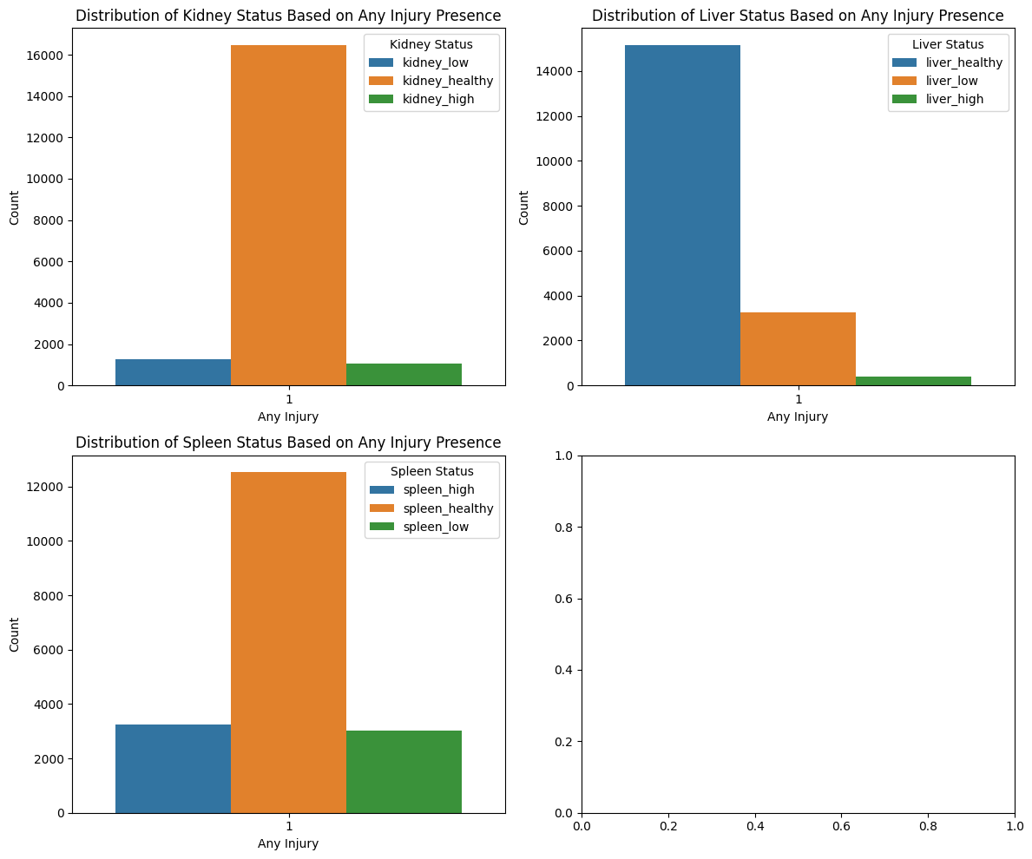
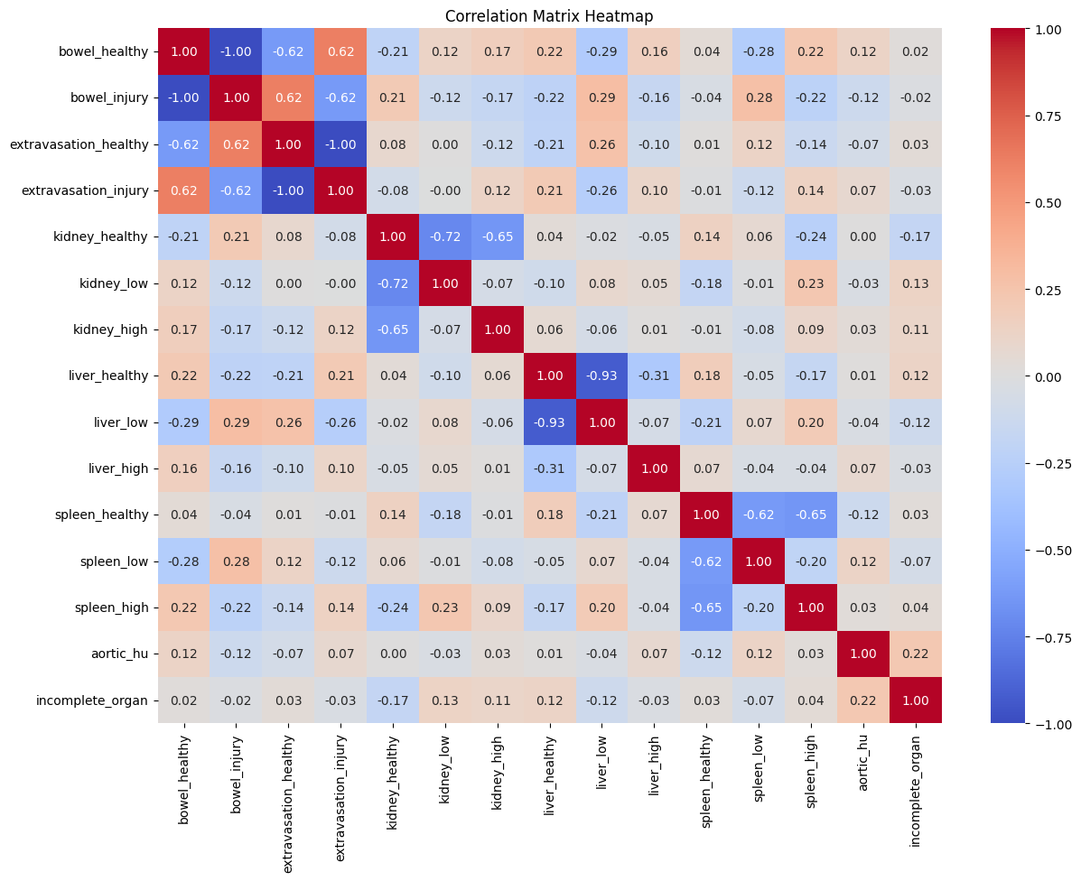
Bivariate EDA
Notes:
These findings further emphasize the significance of organ status features in our predictive models. 'Kidney Status,' 'Liver Status,' and 'Spleen Status' carry substantial weight in predicting injury presence.
- Recognizing that 'Kidney Healthy', 'Liver Healthy' and 'Spleen Healthy' are the most prevalent states in injury cases will help influence the severity levels assigned when an injury is detected in these regions. Such nuanced adjustments based on prevalence patterns enhance the precision of our severity predictions, supporting effective treatment decisions by medical professionals.
- The predominance of healthy organ statuses in the presence of injury is crucial information. It underscores the importance of swiftly identifying cases where organ status deviates from the healthy norm. By incorporating these patterns into our models, we can enhance the clinical applicability of our predictions, aligning with our project objective of providing medical experts essential tools for accurate injury detection and severity classification.
- We plotted **a heatmap** to help identify relationships between binary patient features and the severity of abdominal injuries (indicated by 'aortic_hu') as well as the presence of incomplete organs. Positive values indicate a positive correlation, while negative values indicate a negative correlation.
- Features like 'liver_healthy', 'extravasation_healthy', and 'bowel_injury' have noticeable correlations with 'aortic_hu' meaning they might be crucial indicators of injury severity.
- Correlation between 'kidney_low' and 'kidney_high' with incomplete organ suggest a positive relationship between kidney injuries and the incompleteness of the organ.
- The heatmap therefore helped to identify specific features strongly correlated with injury severity that would aid in refining our model.

Slide 13
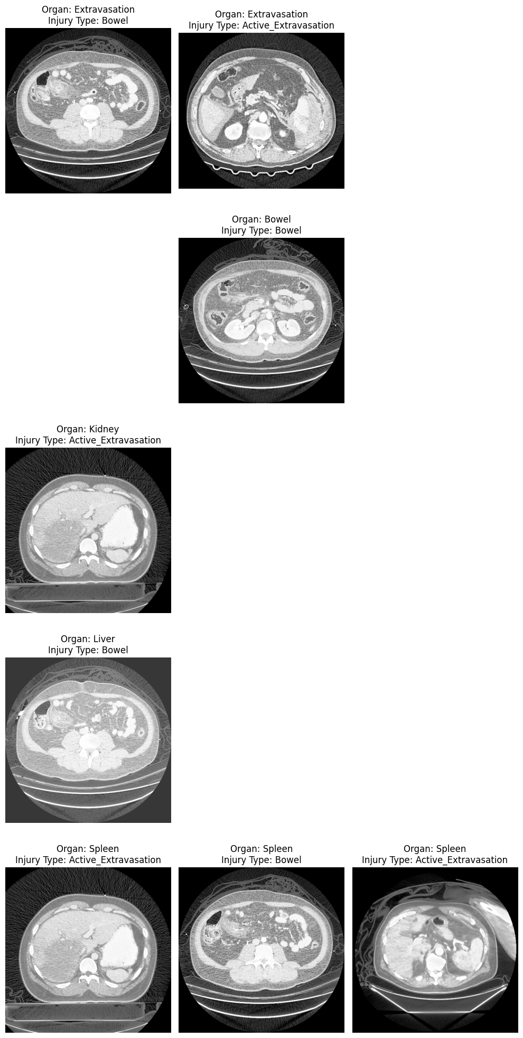
Images: Healthy and Injured Abdominal Organs Comparison
The image shows healthy and injured organs for 5 different patients

Slide 14
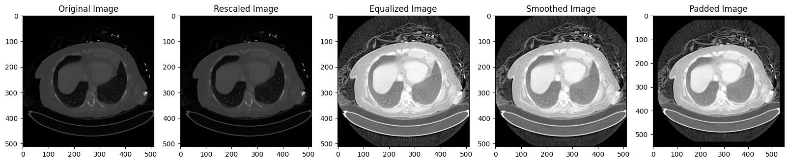
Image Preprocessing
Data preprocessing involved rescaling, equalizing, smoothing and padding the images

Slide 15
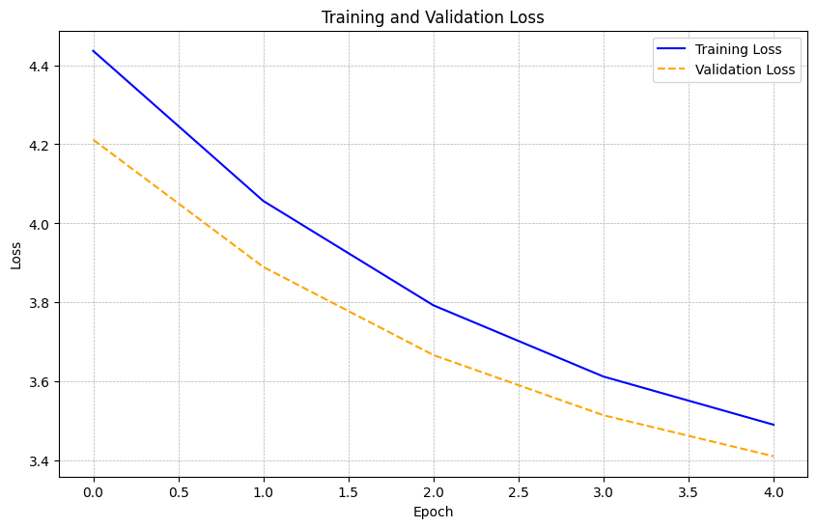
Modelling
Our 3rd model was the best performing:
Total Loss: 3.4111
75/75 accuracy overall, indicating all test cases were correctly classified.
Individual Losses for Organ Classes:
Bowel: 0.6918
Extra: 0.6408
Liver: 0.5498
Kidney: 0.6477
Spleen: 0.8810
Organ-Specific Metrics:
Bowel:
Accuracy: 0.5275
Precision: 0.5304
Extra:
Accuracy: 0.6927
Precision: 0.6946
Liver:
Accuracy: 0.8813
Precision: 0.8821
Kidney:
Accuracy: 0.8147
Precision: 0.8158
Spleen:
Accuracy: 0.6830
Precision: 0.6850

Slide 16
Conclusion
Bowel and extravasation injuries are more common in the presence of any abdominal injury, aiding targeted assessments by medical professionals.
Liver injuries vary in severity, with low severity being prominent, guiding classification and treatment priority.
Rare cases of incomplete organs highlight the need for accurate injury diagnosis in compromised organ visibility.
Interactions between injury types and organ statuses are revealed, directing the model's focus.
Subtle hyperdensity differences indicate injury severity, emphasizing advanced image processing techniques.
Spleen injury detection remains a significant challenge, requiring specific approaches.
Understanding complex Aortic Hounsfield Unit distributions is essential for injury severity assessment.
Addressing class imbalance improves model performance for various organ injuries.
Prioritizing precision reduces false positives, vital in medical contexts.
Careful tuning of the DenseNet121 architecture balances accuracy and false positives.
Model 3 with balanced accuracy, enhanced precision, and consistent performance is a reliable tool for critical medical diagnoses.

Slide 17
Recommendations
Utilize knowledge of common injury combinations (e.g., bowel and extravasation injuries) for more efficient assessments.
Collaborate with practitioners to improve models for accurate diagnosis in cases of compromised organ visibility, using additional imaging techniques or supplementary tests.
Allocate research efforts to address challenges in spleen injury classification through algorithm experimentation and multidisciplinary approaches.
Stay informed about the complexity of Aortic Hounsfield Units (HU) to enhance the development of more effective algorithms
Implement techniques for explainable AI to provide transparency in model predictions, building trust with medical practitioners.

